Slide 1
Priors in Dependency network learning
Sushmita Roy
sroy@biostat.wisc.edu
Computational Network Biology
Biostatistics & Medical Informatics 826
https://compnetbiocourse.discovery.wisc.edu
Oct 11th 2018

Slide 2
Goals for this lecture
Incorporating priors in Dependency networks using linear regression
Incorporating priors in Dependency networks using tree models

Slide 3
Prior-based approaches for network inference
Given
  Gene expression data and
  Complementary data that supports the presences of an edge
    Presence of a sequence motif on a gene promoter
    ChIP-chip/seq binding of factor X on gene Y’s promoter
Do
  Predict which regulators drive the expression of a target gene, while incorporating complementary evidences as much possible
How?
  Place a prior on the graph where the prior is obtained from complementary data

Slide 4
Recall Dependency network
A type of probabilistic graphical model
Approximate Markov networks
  Are much easier to learn from data
As in Bayesian networks has
  A graph structure
  Parameters capturing dependencies between a variable and its parents
Unlike Bayesian network
  Can have cyclic dependencies
  Computing a joint probability is harder
    It is approximated with a “pseudo” likelihood.
Dependency Networks for Inference, Collaborative Filtering and Data visualization
Heckerman, Chickering, Meek, Rounthwaite, Kadie 2000
Notes:
The motivation for this was that Bayesian networks from observational data can really only capture correlational or predictive relationships. If we show a Bayesian network between A,B->C, we can conclude that A,B are predictive of C. Whereas we might wonder why C is not predictive of A.
Often times this causal information is confused with predictive dependencies.

Slide 5
Learning dependency networks
One can think about this problem as estimating the Markov blanket of each random variable
B_{j}
Let B_{j} denote the Markov Blanket of a variable X_{j}.
B_{j} is the set of variables that make X_{j} independent of all other variables, X_{-j}
B_{j} can be estimated by finding the set of variables that best predict X_{j}
This requires us to specify the form of P(X_{j}|B_{j})
?
?
…
?
f_{j}=P(X_{j}|B_{j})
X_{j}
Notes:
----- Meeting Notes (9/15/15 12:12) -----
Is learning easier or harder here?

Slide 6
Overview of the Inferelator algorithm
Based on linear regression models
Handles time series and steady state data
Prior is incorporated at the edge weight using two strategies
  Modified Elastic Net
  Bayesian Best Subset Regression
Greefield et al. 2013, Bonneau et al. 2007

Slide 7
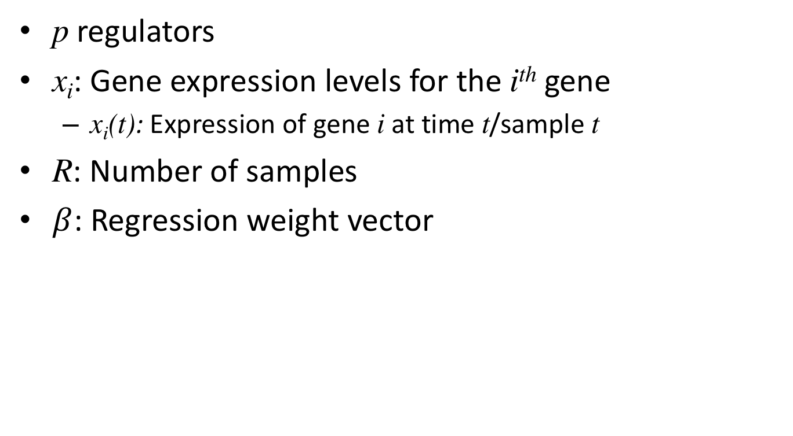
Notation
p regulators
x_{i}: Gene expression levels for the i^{th} gene
  x_{i}(t): Expression of gene i at time t/sample t
R: Number of samples
$β$: Regression weight vector

Slide 8
Modeling the relationship between regulator and target in Inferalator
Change in expression with time
Time series
Steady state
m is the time lag
Number of genes
Number of samples
Network inference: Estimate coefficients

Slide 9
Two approaches to integrate prior graph structure
Modified Elastic Net (MEN)
Bayesian Best Subset Regression (BBSR)

Slide 10
Recall regularized regression
The regularized regression framework can be generally described as follows:
Regularization term
Depending upon f we may have different types of regularized regression frameworks

Slide 11
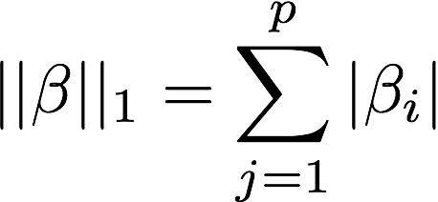
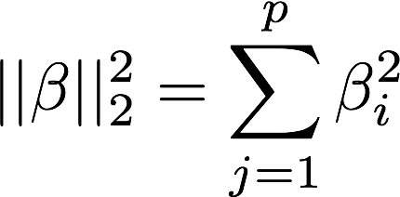
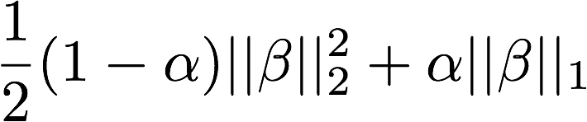
Regularized regression
takes the form of some norm of
L1 norm
L2 norm
Elastic net (Zou & Hastie 2005)

Slide 12
Elastic net regression
If there are correlated predictors, LASSO will arbitrarily decide between the two to include or exclude
Elastic net provides a tradeoff between ridge and LASSO.

Slide 13
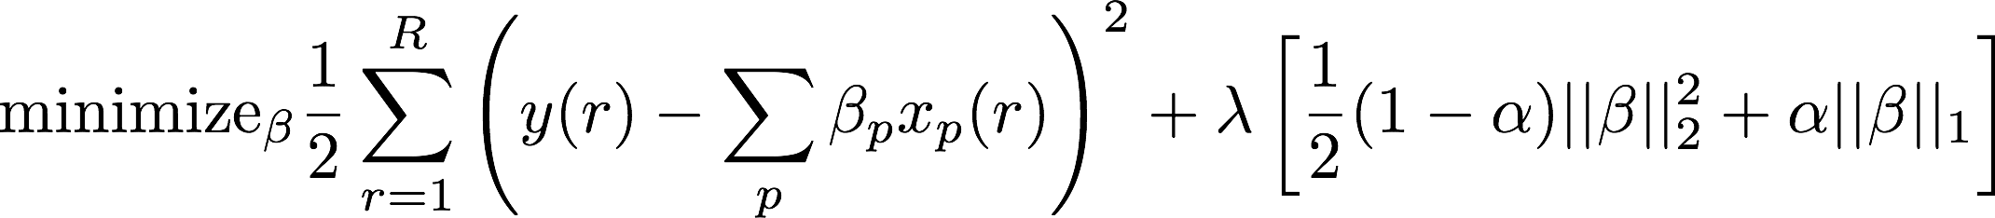
Elastic net regression
Elastic net regression objective for the i^{th} gene
Which can be equivalently written as
Minimize
Subject to
L1 norm
L2 norm
Estimate via cross validation

Slide 14
Modified Elastic Net (MEN)
The modification to Elastic net
Set this <1 so that if there is a prior edge between x_{p}->y_{i}, the regression coefficient will be penalized less

Slide 15
Two approaches to integrate prior graph structure
Modified Elastic Net (MEN)
Bayesian Best Subset Regression (BBSR)

Slide 16
Probabilistic interpretation for the one predictor case
Recall our linear model for one predictor
Assume noise is distributed according a Gaussian with mean 0 and variance σ
How to estimate from N datapoints?
  Maximize likelihood of data given model
Noise

Slide 17
Maximum Likelihood estimate of
Likelihood of data
Taking log
Deriving wrt β₁ and setting to 0
Would get the same answer if minimizing RSS

Slide 18
Probabilistic interpretation in case of p inputs
Assume output Y is
Again can compute likelihood, maximize it to find
Again the ML estimate would be the same as we derived by minimizing the RSS

Slide 19
Bayesian framework to estimate parameters
Instead of optimizing the likelihood, we put a prior on the parameters and optimize the posterior probability of the parameters
Gaussian data likelihood
Parameter prior
What types of priors can we use?

Slide 20
Priors on parameters in regression
Gaussian prior
  Also called ridge regression
Laplace prior
  Also called Lasso regression

Slide 21
Bayesian Best Subset Regression (BBSR)
Based on a Bayesian framework of model selection
  Search among all subsets of regulators and pick the best one to minimize trade off between data fit and model complexity
Assume that the expression level y is distributed according to a Gaussian distribution
Place a prior distribution on parameters, and incorporate prior knowledge of interactions in the parameters
Prior over parameters is a Gaussian
Response variable
Regulators
Prior
A number between 0 and infinity
Notes:
g is used to control to what extent we want the solution to be close to the prior vs the OLS solution. When g is large we will allow the OLS solution to dominate.

Slide 22
BBSR continued
The posterior distribution over the parameters is given as:
can be tuned to provide a trade-off between the prior and the OLS solution
When is larger, beta is closer to the OLS solution
When it is smaller, beta is closer to the prior
The prior is set to be a vector of all 0s

Slide 23
BBSR continued
Inferelator uses a p-dimensional vector for p predictors
Predictors with prior are set to g (push more towards the OLS solution)

Slide 24
BBSR model selection
The final step in BBSR is to determine the best model out 2^{p} possible sets
p cannot be very high: the approach sets p to 10
The best model is the one that minimizes prediction error and has the lowest model complexity

Slide 25
Experimental setup
Three datasets
  DREAM4: In silico dataset with 100 nodes
  E. coli dataset from DREAM5
  B. subtilis dataset
Evaluation based on AUPR
  Ranking of edges obtained from a bootstrapping strategy
Questions asked
  How does the prior parameter affect the performance?
  Does the prior hamper performance on parts of the network without prior support?
  How robust is the framework to noisy priors?

Slide 26
Workflow of experiments

Slide 27
Key questions asked in experiments
How does one pick the prior parameter values?
How does one identify novel edges and not incorporate only the prior?

Slide 28
How does the prior parameter affect the performance?
Notes:
Fig. 2. Effect of weight parameter on performance. We use all GSIs as
the set of PKIs, and evaluate performance (in terms of AUPR) against
the set of GSIs. We evaluate this performance for a variety of choices
of the weight parameter for both methods.
BBSR as expected keeps looking better. For MEN, there is sweet spot. Why is this expected for BBSR and why is it OK in MEN to have sweet spot?

Slide 29
Can the data discriminate between different types of prior edges?
In other words, is the incorporation of prior data-driven?
Low ranked interactions do not have a strong positive or negative correlation
Notes:
Rank inferred edges based on confidence and get the high confidence edges and the low confidence edges of the prior. The high confidence edges have a strong support

Slide 30
Ability to recover new edges is not hampered on adding prior
DREAM4
E. coli
B. subtilis
Prior helps
Prior does not help

Slide 31
What happens when one adds noisy priors?
High noise regime
Low and high in BBSR and MEN means less dense or more dense
Notes:
Non prior methods have an aupr that does not change. BBSR and MEN have a slightly higher performance even without priors. Note, the weight in MEN helps to reduce the penalty. The smaller the theta the the more you will squeeze to 0 and therefore less penalty High weight-> less sparse results in worse performance. Less constraint structures are more susceptible to noisy priors.

Slide 32
Summary
Extending the Inferelator linear regression model to incorporate priors
  Regularized regression
  Probabilistic priors on weights
Experiments suggest
  The prior incorporation is data-driven
  Adding prior is beneficial even if when it is noisy

Slide 33
Goals for this lecture
Incorporating priors in Dependency networks using linear regression
Incorporating priors in Dependency networks using tree models

Slide 34
iRafNet
GENIE3 was shown to be one of the best performing expression-based algorithms
Can we extend the GENIE3 Random Forests based approach to incorporate priors?
iRafNet uses a weighted sampling scheme to incorporate information from different sources of data
Petralia et al. 2015, Bioinformatics

Slide 35
Weighted sampling algorithm in iRafnet
Each data source d provides a score for a regulator k and target j
Convert these scores to sampling weights, w_{k->j} in a data source and score-specific way
For each node split, instead of sampling uniformly from N potential regulators, select a dataset d randomly and sample N regulators based on their weights in d

Slide 36
iRafNet overview
Petralia et al 2015, Bionformatics

Slide 37
Constructing sampling weights
The prior knowledge is described as a set of weighted networks
Weights for selecting a regulator is derived in a dataset specific manner
Undirected protein-protein interactions:
  Weights derived from a diffusion process over graphs (we will see this later lectures)
Time-series expression data
  Weight w_{j->k} assess how predictive g_{j}’s expression at time t is of g_{i}’s expression at a future time point t+1
  Derive a P-value to assess the strength of the regression weight
  Convert P-value into a weight
Knockout data
  w_{j->k} either are derived in multiple ways:
    If g_{k}’s expression changes significantly when g_{k} is knocked w_{j->k} is derived from the P-value
    Otherwise it is derived based on the overlap of g_{j} and g_{k}’s knockout targets or knockout regulators

Slide 38
iRafNet application to real data
Ground truth
  Significant interactions identified from ChIP-chip experiments of yeast
Expression dataset
  This was a large study measuring gene expression in multiple yeast strains
Prior datasets (included other expression datasets)
  Expression time course during cell cycle
  Expression data of genetic knockouts of TFs
  Protein-protein interactions from public databases (BioGRID, MINT, DIP)

Slide 39
Does adding prior help for iRafNet?
Evaluate on ChIP-chip network of yeast
Expression dataset
  This was a large study measuring gene expression
Prior datasets (included other expression datasets)
  Expression time course during cell cycle
  Knockout data from Hu et al
  Protein-protein interactions from public databases (BioGRID, MINT, DIP)

Slide 40
Concluding remarks
We have seen different ways to incorporate other data types to improve the quality of the inferred network
Bayesian networks with structure prior
  Use an energy function to assess concordance
  Sensitive to incorrect prior information
Dependency networks with priors
  Linear regression approach aims to reduce the penalty on inferred edges
  Tree-based approach enables a “biased” selection of regulators

