Slide 1
Dependency networks
Sushmita Roy
sroy@biostat.wisc.edu
Computational Network Biology
Biostatistics & Medical Informatics 826
https://compnetbiocourse.discovery.wisc.edu
Sep 27th 2018

Slide 2
Plan for this section
Overview of network inference (Sep 18th)
Directed probabilistic graphical models Bayesian networks (Sep 18th, Sep 20th)
Gaussian graphical models (Sep 25th)
Dependency networks (Sep 27th)
Integrating prior information for network inference (Oct 2^{nd,} 4th)

Slide 3
Goals for today
Dependency networks
GENIE3
Evaluation of expression-based network inference methods

Slide 4
Recall the different types of probabilistic graphs
In each graph type we can assert different conditional independencies
Correlation networks
Markov networks
  Gaussian Graphical models
Dependency networks
Bayesian networks

Slide 5
Dependency network
A type of probabilistic graphical model
Approximate Markov networks
  Are much easier to learn from data
As in Bayesian networks has
  A graph structure
  Parameters capturing dependencies between a variable and its parents
Unlike Bayesian network
  Can have cyclic dependencies
  Computing a joint probability is harder
    It is approximated with a “pseudo” likelihood.
Dependency Networks for Inference, Collaborative Filtering and Data visualization
Heckerman, Chickering, Meek, Rounthwaite, Kadie 2000
Notes:
The motivation for this was that Bayesian networks from observational data can really only capture correlational or predictive relationships. If we show a Bayesian network between A,B->C, we can conclude that A,B are predictive of C. Whereas we might wonder why C is not predictive of A.
Often times this causal information is confused with predictive dependencies.

Slide 6
Original motivation of dependency networks
Introduced by Heckerman, Chickering, Meek, et al 2000
Often times Bayesian networks can get confusing
  Bayesian networks learned represent correlation or predictive relationships
  But the directionality of the edges are mistakenly interpreted as causal connections
(Consistent) Dependency networks were introduced to distinguish between these cases

Slide 7
Dependency network vs Bayesian network
Bayesian network
Dependency network
Often times, the Bayesian network on the left is read as if “Age” determines “Income”. However, all this model is capturing is that “Age” is predictive of “Income”.
Dependency Networks for Inference, Collaborative Filtering and Data visualization
Heckerman, Chickering, Meek, Rounthwaite, Kadie 2000

Slide 8
Learning dependency networks
Entails estimating the Markov blanket of each random variable
B_{j}
Let B_{j} denote the Markov Blanket of a variable X_{j}.
X_{-j} denotes all variables other than X_{j}
Given B_{j}, X_{j} is independent of all other variables, X_{-j}
B_{j} can be estimated by finding the set of variables that best predict X_{j}
This requires us to specify the form of P(X_{j}|B_{j})
?
?
…
?
f_{j}=P(X_{j}|B_{j})
X_{j}
Notes:
----- Meeting Notes (9/15/15 12:12) -----
Is learning easier or harder here?

Slide 9
Different representations of f_{j}=P(X_{j}|B_{j})
If X_{j} is continuous
  f_{j} can be a linear function
  f_{j} can be a regression tree
  f_{j} can be an ensemble of trees
    E.g. random forests
If X_{j} is discrete
  f_{j} can be a conditional probability table
  f_{j} can be a conditional probability tree

Slide 10
Popular dependency networks implementations
Learned by solving a set of linear regression problems
    TIGRESS (Haury et al, 2010)
      Uses a constraint to learn a “sparse” Markov blanket
      Uses “stability selection” to estimate confidence of edges
Learned by solving a set of non-linear regression problems
  Non-linearity captured by Regression Tree (Heckerman et al, 2000)
  GENIE3: Non-linearity captured by Random forest (Huynh-Thu et al, 2010)
  Inferelator (Bonneau et al, Genome Biology 2005)
    Can handle time course and single time point data
    Non-linear regression is done using a logistic transform
    Handles linear and non-linear regression

Slide 11
Goals for today
Dependency networks
GENIE3
Evaluation of expression-based network inference methods

Slide 12

Expression data matrix
N Experiments/Time points etc
$$x_{−j}^{(i)}$$
Observations of variable X_{j} in all m experiments
p Genes
Observations (expression levels) of all variables in sample i

Slide 13
GENIE3: GEne Network Inference with Ensemble of trees
Solves a set of regression problems
  One per random variable
  Minimizes the prediction error per variable X_{j}
Uses an Ensemble of regression trees to represent f_{j}
  Models non-linear dependencies
Outputs a directed cyclic graph with a confidence of each edge
  Directionality means “good predictor”
Focus on generating a ranking over edges rather than a graph structure and parameters
  Rank is determined by confidence
Inferring Regulatory Networks from Expression Data Using Tree-Based Methods Van Anh Huynh-Thu, Alexandre Irrthum, Louis Wehenkel, Pierre Geurts, Plos One 2010

Slide 14
Recall our very simple regression tree for two variables
The tree specifies X₃ as a function of X₂
Interior nodes
X₂ > e₁
e₁
e₂
NO
YES
X₃
X₂ > e₂
Leaf nodes
NO
YES
X₂
X₃

Slide 15
Prediction of X_{j} using a single tree
leaf nodes
x_{-j}
split nodes
Prediction is the mean at each leaf node
Taken from ICCV09 tutorial by Kim, Shotton and Stenger: http://www.iis.ee.ic.ac.uk/~tkkim/iccv09_tutorial

Slide 16
Prediction example with a regression tree
AMAT
INTL
DELL
DELL
Suppose we observe AMAT=10% and INTL=7%
What is DELL’s predicted value?
1.4

Slide 17
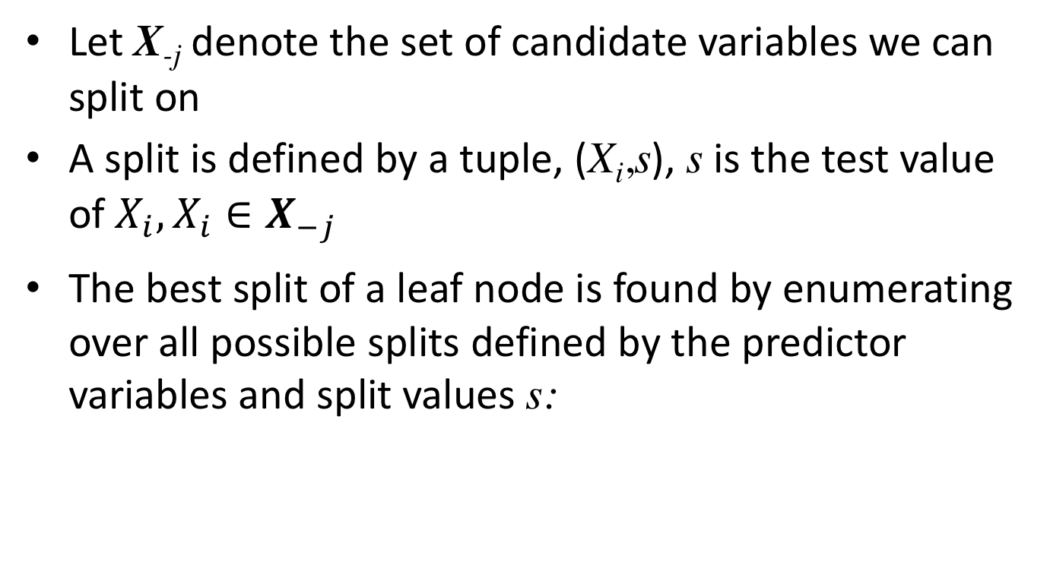
Quantifying a split on the tree
Let X_{-j} denote the set of candidate variables we can split on
A split is defined by a tuple, (X_{i},s), s is the test value of $X_{i},{X_{i}∈X_{−j}}_{}$
The best split of a leaf node is found by enumerating over all possible splits defined by the predictor variables and split values s:
The set of samples in the left node
The set of samples in the right node
S_{left} and S_{right} are sets of samples obtained by testing X_{i} for a particular split s

Slide 18
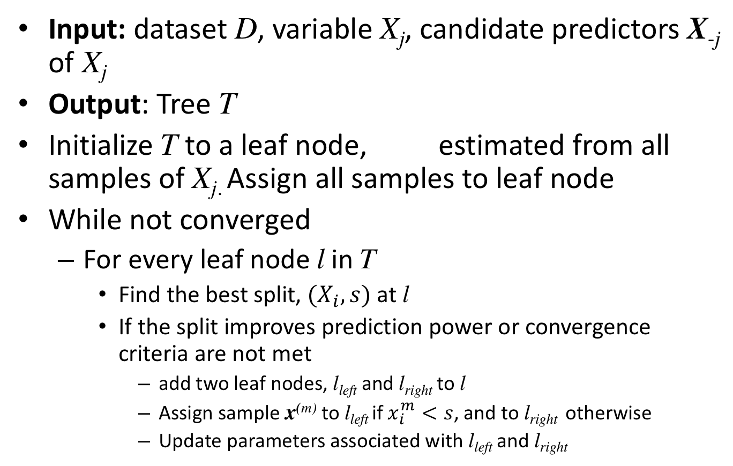
Algorithm for learning a regression tree
Input: dataset D, variable X_{j}, candidate predictors X_{-j} of X_{j}
Output: Tree T
Initialize T to a leaf node, estimated from all samples of X_{j.} Assign all samples to leaf node
While not converged
  For every leaf node l in T
    Find the best split, $(X_{i}, s)$ at l
    If the split improves prediction power or convergence criteria are not met
      add two leaf nodes, l_{left} and l_{right} to l
      Assign sample x^{(m)} to l_{left} if $x_{i}^{m}<s$, and to l_{right} otherwise
      Update parameters associated with l_{left} and l_{right}
Notes:
----- Meeting Notes (11/20/14 09:11) -----
this assumes Xi does not have any parents yet

Slide 19
One iteration of regression tree learning
Let X={X₁,X₂,X₃,X₄}
Assume we are searching for the neighbors of X₃ and it already has two neighbors X₁ and X₂
X_{1,} X_{2,} X₄ will all be considered as candidate splits using the examples at each current leaf node
If we split on X₄, then we will have a new neighbor.
Iteration i+1
Iteration i
X₁ > e₁
X₁ > e₁
NO
NO
YES
X₂ > e₂
X₂ > e₂
YES
NO
YES
NO
YES
X₄ > e₃
N₂
N₃
N₁
N₂
N₃
NO
YES
N_{l:} Gaussian associated with leaf l
N₄
N₅

Slide 20
Convergence criteria
Minimum number of examples at a leaf node
Depth of a tree
Error tolerance

Slide 21
An Ensemble of trees
A single tree is prone to “overfitting”
Instead of learning a single tree, ensemble models make use of a collection of trees

Slide 22
Prediction using an Ensemble of Trees
  Prediction is
leaf nodes
split nodes
x_{-j}
x_{-j}
tree₁
tree_{T}
……
Taken from ICCV09 tutorial by Kim, Shotton and Stenger: http://www.iis.ee.ic.ac.uk/~tkkim/iccv09_tutorial

Slide 23
Expression data matrix
N Experiments/Time points etc
Observations (expression levels) of all variables in sample i
Observations of X_{j} in all m experiments
p Genes
p Genes
N Experiments
GENIE3 will use the transpose of this data matrix
Observations (expression levels) of all variables in sample i

Slide 24
GENIE3 algorithm sketch
Predictor ranking
Figure from Huynh-Thu et al.

Slide 25
GENIE3 algorithm sketch
For each X_{j}, generate learning samples of input/output pairs
  LS_{j}={(x_{-j}^{k},x_{j}^{k}), k=1..N}
  On each LS_{j} learn f_{j} to predict the value of X_{j}
  f_{j} is an ensemble of regression trees
  Estimate w_{ij} for all genes i ≠ j
    w_{ij} quantifies the confidence of the edge between X_{i} and X_{j}
    Associated with the decrease in variance of X_{j} when X_{i} is included in f_{j}
Generate a global ranking of edges based on each w_{ij}

Slide 26
Learning f_{j} in GENIE3
Uses two types of Ensembles to represent the f_{j}:
  Random forest or Extra Trees
Learning the Random forest
  Generate M=1000 bootstrap samples
  At each node to be split, search for best split among K randomly selected variables
  K was set to p-1 or (p-1)^{1/2,} where p is the number of regulators/parents
Learning the Extra-Trees
  Learn 1000 trees
  Each tree is built from the original learning sample
  At each node, the best split is determined among K random splits, each split determined by randomly selecting one input (without replacement) and a threshold

Slide 27
Computing the importance weight of a predictor
Importance is computed at each interior node
Remember each predictor can show up multiple times as interior nodes
For an interior node, importance is given by the reduction in variance when splitting on that node
Interior node
Set of data samples that reach this node
#S: Size of the set S
Var(S): variance of the output variable x_{j} in set S
S_{t}: subset of S when a test at N is true
S_{f}: subset of S when a test at N is false

Slide 28
Computing the importance weight of a predictor
For a single tree the overall importance is then sum over all points in the tree where this node is used to split
For an ensemble the importance is averaged over all trees
To avoid bias towards highly variable genes, normalize the expression genes to all have unit variance

Slide 29
Goals for today
Dependency networks
GENIE3
Evaluation of expression-based network inference methods

Slide 30
Evaluating the network
Assessing confidence
Area under the precision recall curve
Do modules or target sets of genes participate in coherent function?
Can the network predict expression in a new condition?

Slide 31
Assessing confidence in the learned network
Typically the number of training samples is not sufficient to reliably determine the “right” network
One can however estimate the confidence of specific features of the network
  Graph features f(G)
Examples of f(G)
  An edge between two random variables
  Order relations: Is X, Y’s ancestor?

Slide 32
How to assess confidence in graph features?
What we want is P(f(G)|D), which is
But it is not feasible to compute this sum
Instead we will use a “bootstrap” procedure

Slide 33
Bootstrap to assess graph feature confidence
For i=1 to m
  Construct dataset D_{i} by sampling with replacement N samples from dataset D, where N is the size of the original D
  Learn a graphical model {G_{i,}Θ_{i}}
For each feature of interest f, calculate confidence

Slide 34
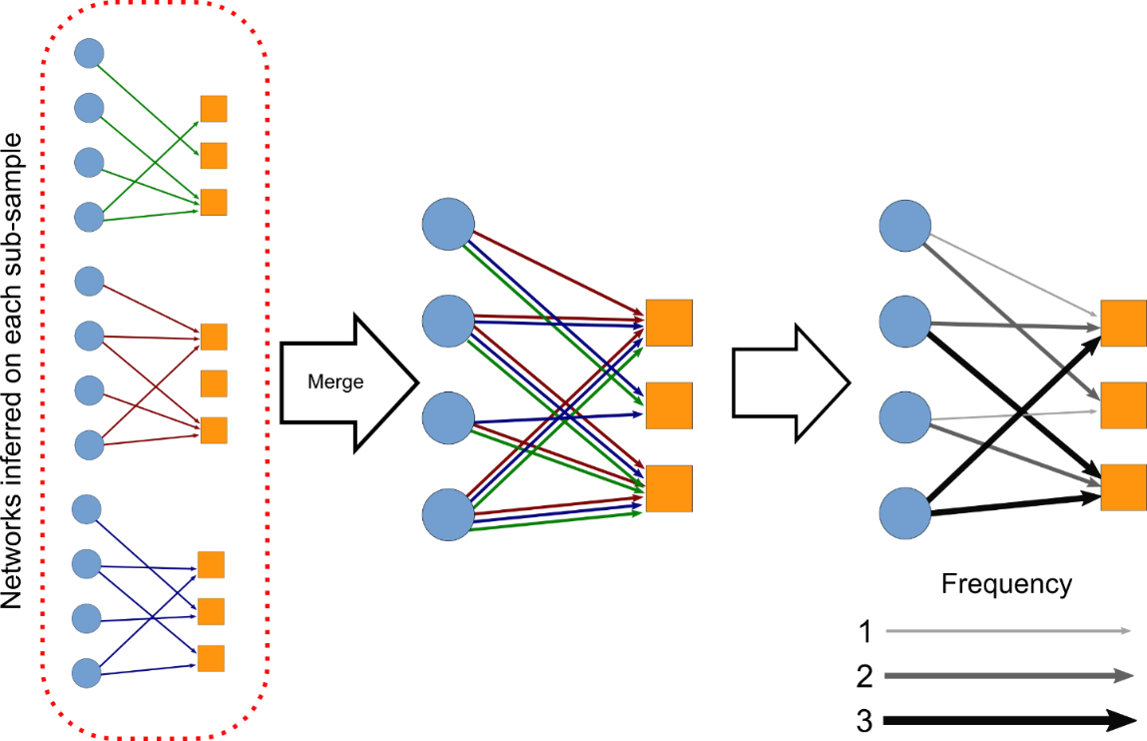
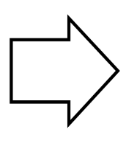
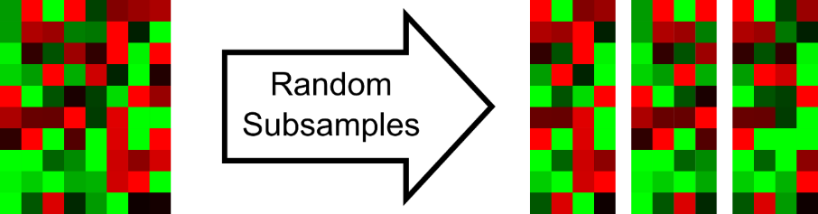
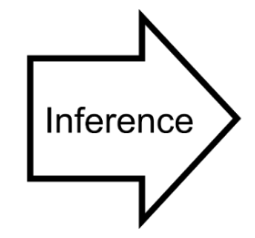
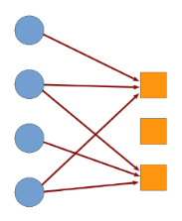
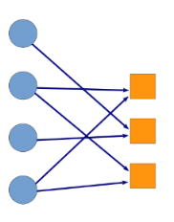
Bootstrap/stability selection
Final inferred
network
Expression data
Output
Input
34

Slide 35
Does the bootstrap confidence represent real relationships?
Compare the confidence distribution to that obtained from randomized data
Shuffle the columns of each row (gene) separately
Repeat the bootstrap procedure
Experimental conditions
genes
randomize each
row independently
Slide credit Prof. Mark Craven

Slide 36
Bootstrap-based confidence differs between real and actual data
f
Real
Random
f
Friedman et al 2000

Slide 37
Example of a high confidence sub-network
One learned Bayesian network
Bootstrapped confidence Bayesian network: highlights a subnetwork associated with yeast mating pathway. Colors indicate genes with known functions.
Nir Friedman, Science 2004

Slide 38
Area under the precision recall curve (AUPR)
Assume we know what the “right” network is
One can use Precision-Recall curves to evaluate the predicted network
Area under the PR curve (AUPR) curve quantifies performance
Precision=
Recall=
# of correct edges
# of correct edges
# of predicted edges
# of true edges

Slide 39
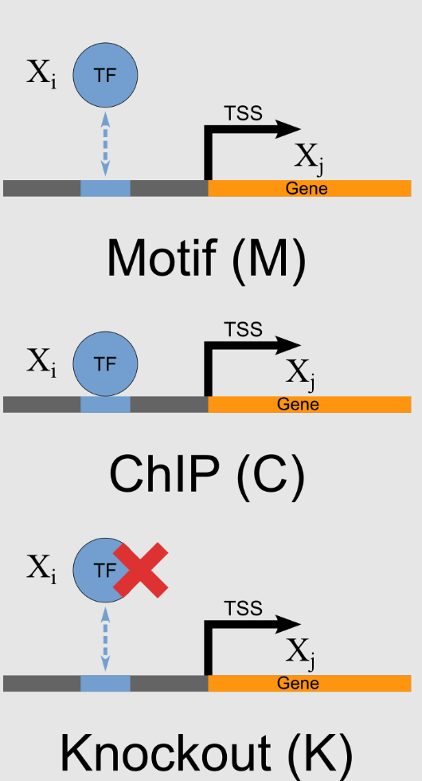
Experimental datasets to assess network structure for gene regulatory networks
  Sequence specific motifs
  ChIP-chip and ChIP-seq
  Factor knockout followed by whole-transcriptome profiling

Slide 40
AUPR based performance comparison

Slide 41
DREAM: Dialogue for reverse engineeting assessments and methods
Community effort to assess regulatory network inference
DREAM 5 challenge
Previous challenges: 2006, 2007, 2008, 2009, 2010
Marbach et al. 2012, Nature Methods

Slide 42
Where do different methods rank?
Random
Community
Marbach et al., 2012
These approaches were mostly per-gene
Notes:
GENIE3 was in the OTHER category Method 1.

Slide 43
Methods tend to cluster together
These approaches were mostly per-gene
Marbach et al., 2012

Slide 44
Comparing per-module (LeMoNe) and per-gene (CLR) methods
Marchal & De Smet, Nature Reviews Microbiology, 2010
Notes:
CLR: more range of factors. Module-based methods: works better for TFs that have larger targets.

Slide 45
Some comments about expression-based network inference methods
We have seen multiple types of algorithms to learn these networks
  Per-gene methods (learn regulators for individual genes)
    Sparse candidate, GENIE3, ARACNE, CLR
  Per-module methods
    Module networks: learn regulators for sets of genes/modules
    Other implementations of module networks exist
      LIRNET: Learning a Prior on Regulatory Potential from eQTL Data (Su In Lee et al, Plos genetics 2009, http://www.plosgenetics.org/article/info%3Adoi%2F10.1371%2Fjournal.pgen.1000358)
      LeMoNe: Learning Module Networks (Michoel et al 2007, http://www.biomedcentral.com/1471-2105/8/S2/S5)
  Methods that combine per-gene and per-module (MERLIN)
Methods differ in
  how they quantify dependence between genes
  Higher-order or pairwise
  Focus on structure or structure & parameters
Expression alone is not enough to infer the structure of the network
Integrative approaches that combine expression with other types of data are likely more successful (next lectures)

Slide 46
References
Markowetz, Florian and Rainer Spang. "Inferring cellular networks-a review.." BMC bioinformatics 8 Suppl 6 (2007): S5+.
N. Friedman, M. Linial, I. Nachman, and D. Pe'er, "Using bayesian networks to analyze expression data," Journal of Computational Biology, vol. 7, no. 3-4, pp. 601-620, Aug. 2000. [Online]. Available: http://dx.doi.org/10.1089/106652700750050961
Dependency Networks for Inference, Collaborative Filtering and Data visualization Heckerman, Chickering, Meek, Rounthwaite, Kadie 2000
Inferring Regulatory Networks from Expression Data Using Tree-Based Methods Van Anh Huynh-Thu, Alexandre Irrthum, Louis Wehenkel, Pierre Geurts, Plos One 2010
D. Marbach et al., "Wisdom of crowds for robust gene network inference," Nature Methods, vol. 9, no. 8, pp. 796-804, Jul. 2012. [Online]. Available: http://dx.doi.org/10.1038/nmeth.
R. De Smet and K. Marchal, "Advantages and limitations of current network inference methods." Nature reviews. Microbiology, vol. 8, no. 10, pp. 717-729, Oct. 2010. [Online]. Available: http://dx.doi.org/10.1038/nrmicro2419

